Slide 1
Smrekar Superstores FY20 Sales Analysis
Mathias J. Smrekar

Slide 2
Goals
Analyze FY2020 sales data from all three Smrekar Superstore branch locations
Analyze sales data trends to identify options to improve profitability
Develop recommendations for the leadership team based on analyses

Slide 3
Analysis Questions
How did FY2020 performance, in terms of total sales and avg. gross margin, vary by branch?
How did FY2020 customer satisfaction vary by branch?
Is there a statistically significant difference between FY2020 avg. gross margin on sales made to men vs. sales made to women?
How did FY2020 avg. gross margin vary by product category?
Is there a statistically significant difference between FY2020 avg. gross margin on sales of the product category with the highest avg. gross margin vs. sales of the product category with the lowest avg. gross margin

Slide 4
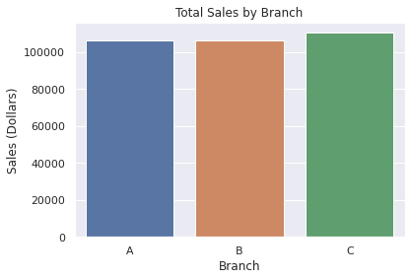
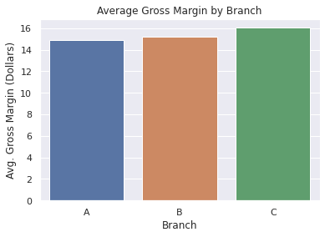
Findings: Branch Sales and Avg. Gross Margin
Total Sales
Branch A: $106,200
Branch B: $106,197
Branch C: $110,568
Avg. Gross Margin
Branch A: $14.87
Branch B: $15.23
Branch C: $16.05
Rejected the null hypothesis that total sales and gross margin did not differ between branch locations.

Slide 5
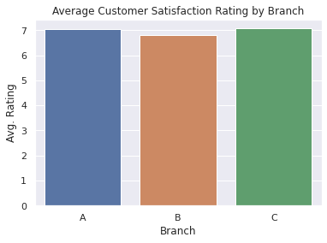
Findings: Customer Satisfaction by Branch
Avg. customer satisfaction ratings
Branch A: 7.03
Branch B: 6.82
Branch C: 7.07
Reject the null hypothesis that customer satisfaction did not differ between branch locations.

Slide 6
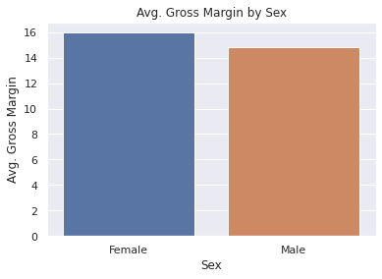
Findings: Male vs. Female Gross Margins
Avg. gross margin on sales
Women: $15.96
Men: $14.80
The difference was not statistically significant (p = .12)
Failed to reject the null hypothesis of no statistical significance in difference between avg. gross margin on sales made to women vs. men.

Slide 7
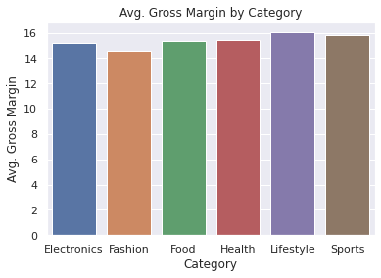
Findings: Product Category Gross Margin
Avg. gross margin was highest on sales on lifestyle products ($16.03)
Avg. gross margin was lowest on sales of fashion accessories ($14.53)
The difference between avg. gross margin on sales of lifestyle products vs. fashion accessories was not statistically significant (p = .25).
Rejected null hypotheses that no differences existed.
Failed to reject the null hypothesis of no statistical significance of difference between highest and lowedst avg. gross margin.

Slide 8
Recommendations
Conduct further data collection and/or analyses to identify variables contributing to the successes, in terms of sales, average gross margin on sales, and customer satisfaction, at Branch C relative to Branch A and Branch B.
Conduct additional analyses of FY2020 sales data to determine the types of products more frequently purchased by women.
Consider potential routes for boosting FY2021 sales of lifestyle products.

Slide 9
Questions?
mathiasjsmrekar@gmail.com
612.419.1819

